Slide 1
Complex State in React
Mary Shaw
Engineering Lead @ FamilySearch
25 years of web dev

Slide 2

Complex React State Defined:
Many interconnected state changes
In many React components

Slide 3
Why Does managing state well Matter?
Well organized code is easier to test, refactor, & improve.
Less maintenance effort is cheaper to keep your product running.
The longer a product lives, the more maintenance matters.

Slide 4
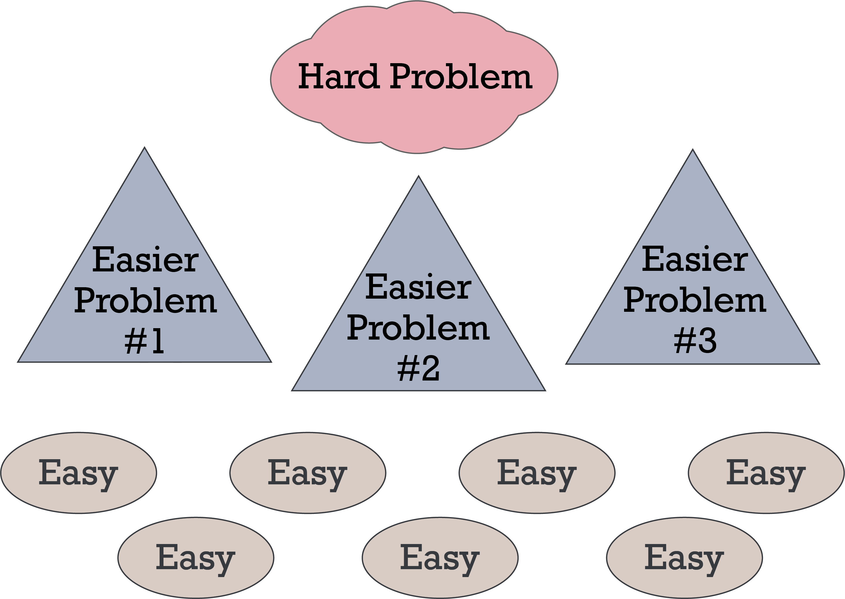
#1 Rule of Complex State: Break It Up!!

Slide 5
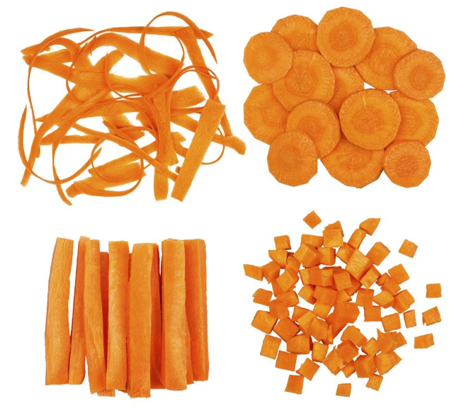
Breaking Up – or Breaking Down – “State”
The answers are never “one size fits all”
We’ll go over the building blocks
Then we’ll discuss combining them

Slide 6
State Building Blocks for Complex Apps
State Management
State Buckets
Composition

Slide 7
React State Management Building Blocks
Props
Derived Variables
useState
use-
Reducer

Slide 8
Props
Component parameters
function Welcome(props) { return <h1>Hello, {props.name}</h1> }
function Welcome({ name }) { return <h1>Hello, {name}</h1> }
Useful for passing state
from one component to another

Slide 9
Derived Variables
… are derived from other state at render time
Reset every render
function Welcome({ name }) { const { t } = useTranslation() const message = t(`Hello, ${name}`) return <h1>{message}</h1> }
Cache and reset when
necessary using useMemo()
const collectionDetails = useMemo(() => { return getCollectionDetails(record) }, [record])
Useful when a variable
only changes on render

Slide 10
useState
A state variable that can be modified outside of initial render
Default is only used on first render
Or until changed
export function StateExample() { const [state, setState] = useState(initialState)
return <InnerComponent state={state} /> }
Can be updated outside render cycle
Can be passed to lower components
Useful for simple scenarios
with updates outside of render

Slide 11
useReducer
A state machine for more complex state
API intimidates some people, but it’s not that hard (once you learn!).
Useful for changing multiple interconnected variables in lock-step

Slide 12
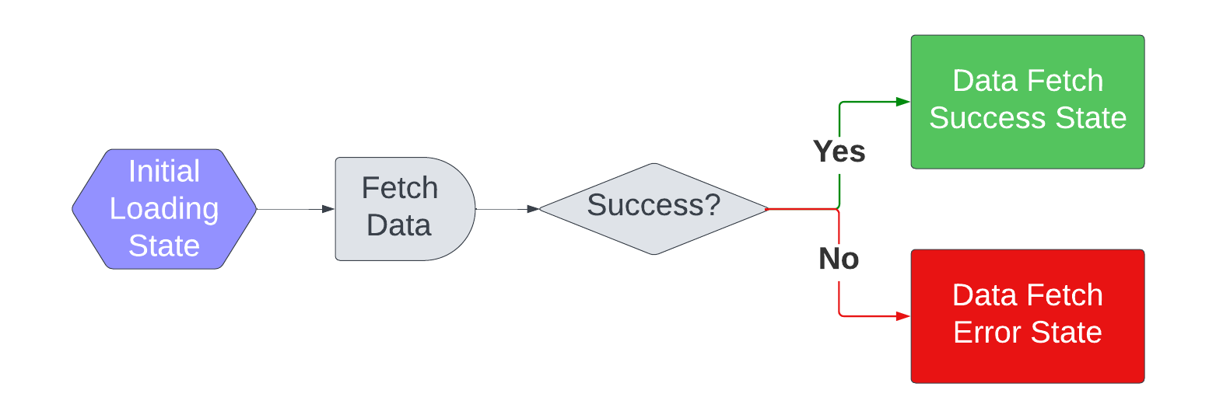
useReducer Example
Data fetching in custom hook, “useCollection”
Notes:
Reducer holds states – loading, success, error

Slide 13
useReducer Example: Data Fetching
A reducer is often a pure function with a switch statement.
function loadingReducer(state, action) { switch (action.type) {
case 'response': return { data: action.response, status: 'loaded', error: null, } } }
case 'error': return { data: null, status: 'error', error: action.error, }
case 'loading': return { data: null, status: 'loading', error: null, }
Data Fetch Success
Data Fetch Error
Initial Loading State
Notes:
“Pure” just means no side effects. Don’t do data fetching inside the reducer; instead you will update state in the reducer.

Slide 14
useReducer: 1. Initialize
State: Interconnected state is all in one object
Dispatch: Function for changing state
const [state, dispatch] = useReducer(loadingReducer, { data: null, status: 'loading', error: null, })
Initial State
(Loading in this example)
Initialization can also happen in a function
Notes:
If you have a complex reducer, you’ll most likely want to use the function option for Initializing the reducer

Slide 15
useReducer: 2. Change State
Handle response and error states
Handle Response State
getCollectionDetails(collectionId) .then((response) => { dispatch({ type: 'response', response }) }) .catch((error) => { dispatch({ type: 'error', error }) })
Handle Error State

Slide 16
useReducer: 3. Use in Custom Hook
Custom Hook Name: “use…”
export function useCollection({collectionId}) { const [state, dispatch] = useReducer(loadingReducer, { data: null, status: 'loading', error: null, }) useEffect(() => { let cancelled = false // Get the data and handle success/error appropriately getCollectionDetails({ collectionId }) …. return () => { cancelled = true } }, [collectionId]) return [state.data, state.status, state.error] }
Call useReducer
Do a thing, call “dispatch” to change state
Return state from custom hook

Slide 17
useReducer: 4. Use Custom Hook
Call custom hook for reducer states
const [collection, status, error] = useCollection(collectionId)
if (status === ‘error') { return <UnknownError /> } if (status === 'loading') return <Skeleton /> } return <Component collection={collection} />
Handle each state in UI
Notes:
Complicated reducers are best handled in a custom hook, and/or context.
You can always expose functions that trigger one of the dispatches

Slide 18
useReducer: Basic Unit Testing
Test every UI case in a unit test. In our example:
Loading
Error
Data Loaded
Testing the error case
test('renders not found page for invalid collection ID’, async () => { render(<CollectionDetailsRoute collectionId="bogusCollectionId" />) const notFound = await screen.findByText(‘not found') expect(notFound).toBeInTheDocument() })

Slide 19
useReducer: Complex Unit Tests
useReducer itself is part of the UI framework.
Move complex logic into separate functions, test those independently
If you need to test your reducer independently of UI:
Option 1: A fake UI
Make a component that displays state
Then, test the sample component
This allows you to set up a more testable UI
Option 2: Use react-hooks-testing-library

Slide 20
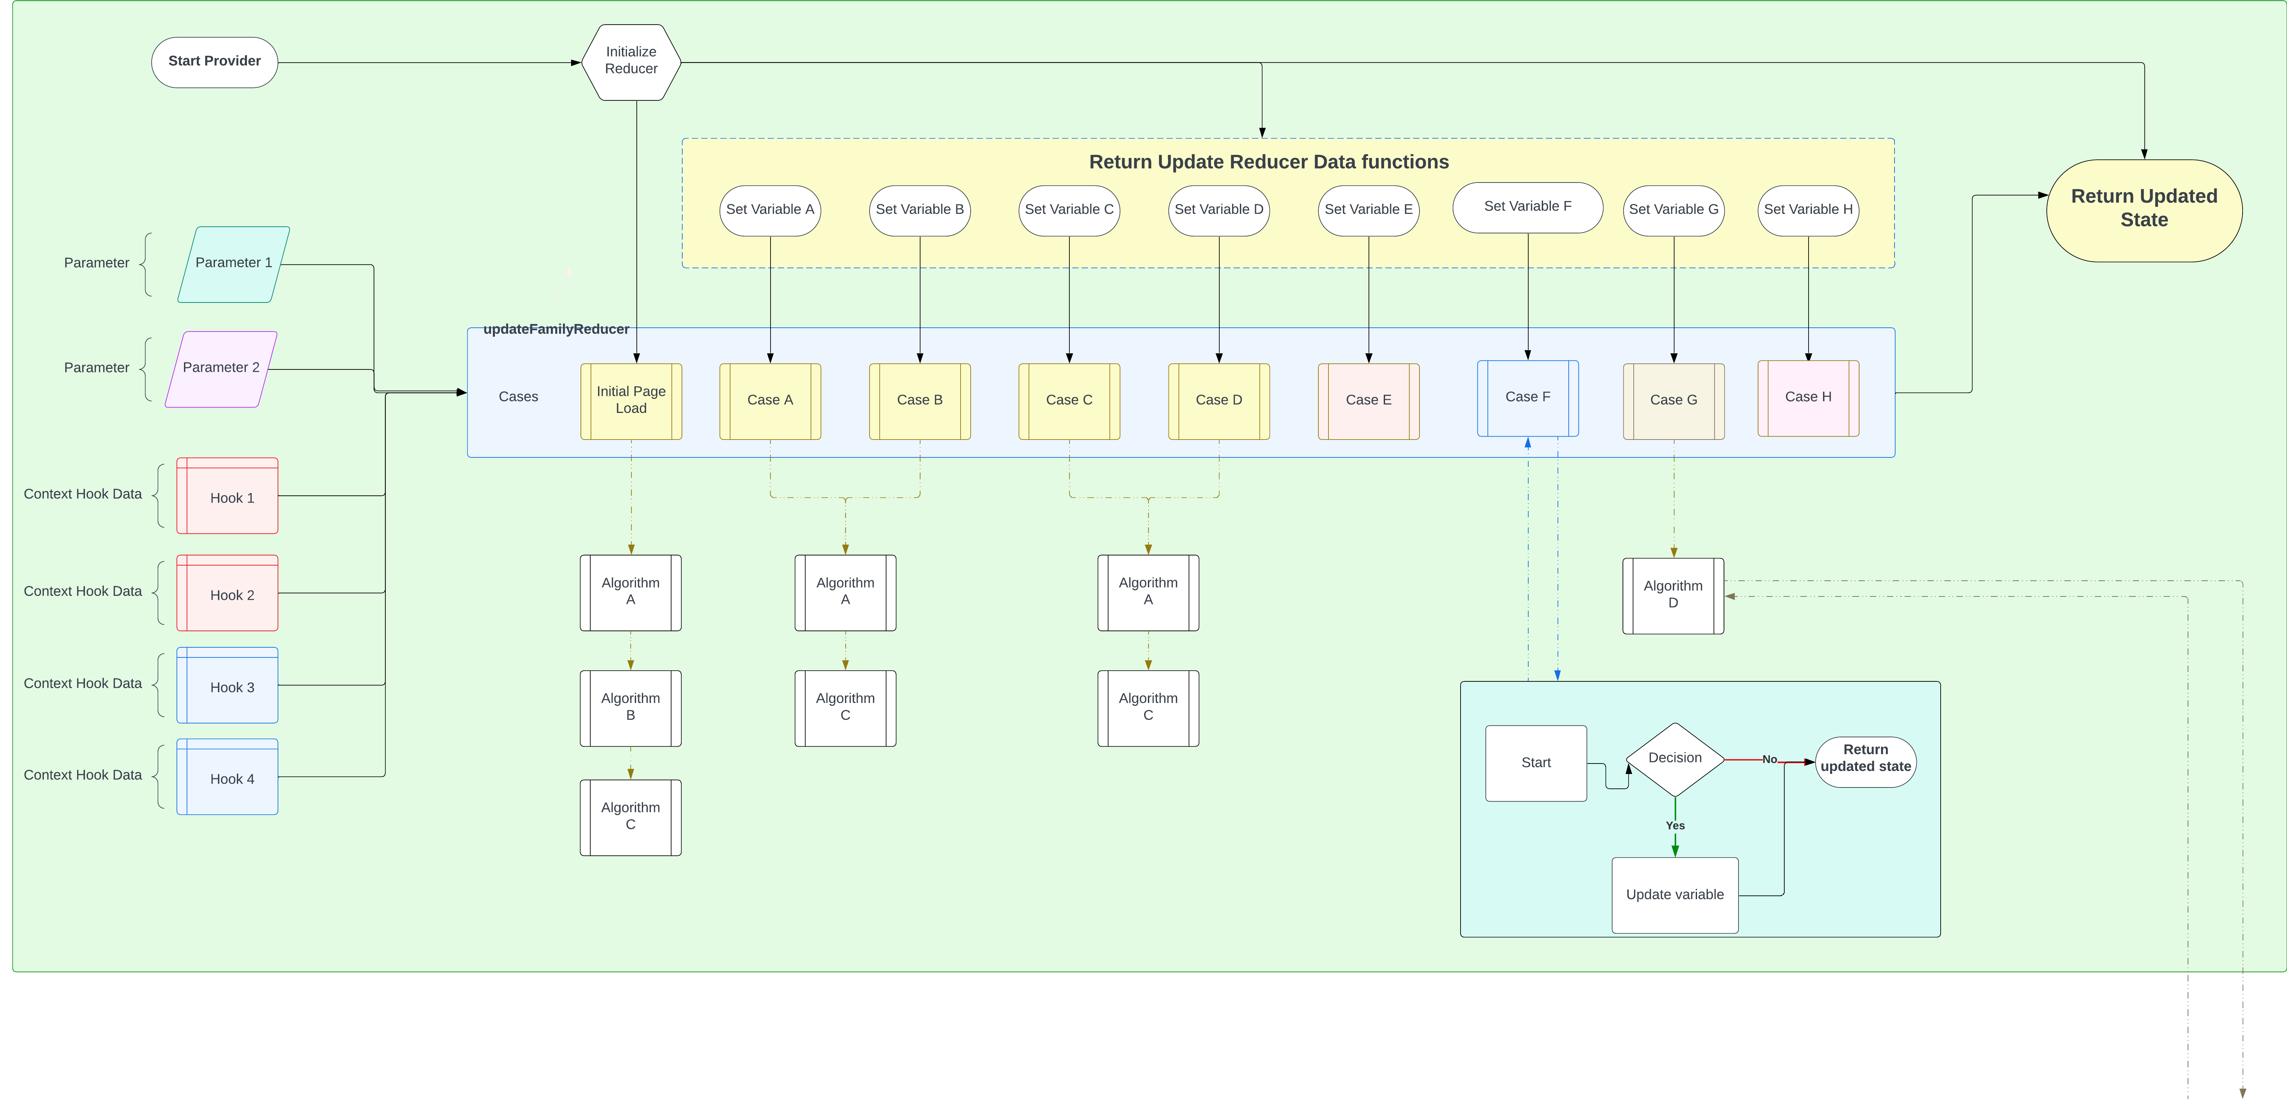
useReducer: Best for interconnected state
Notes:
useReducer is a really good choice for interconnected state. We use reducers a lot in Source Linker.

Slide 21
React State Buckets
Contexts
Other State Buckets
Custom Hooks

Slide 22
Custom Hooks are kinda sorta state buckets…
Combine various similar state data
Possibly use Contexts
Possibly use other custom hooks
function useRecordInfo() { const { father, mother, children } = useRecordFamily() const { recordName, recordURL} = useRecordData() return { father, mother, children, recordName, recordURL } }
Return an organized state object
Maybe return functions to
change state outside hook

Slide 23
Contexts
Broadcast/share state among child components
Context Provider
Context Consumer
Context Consumer

Slide 24
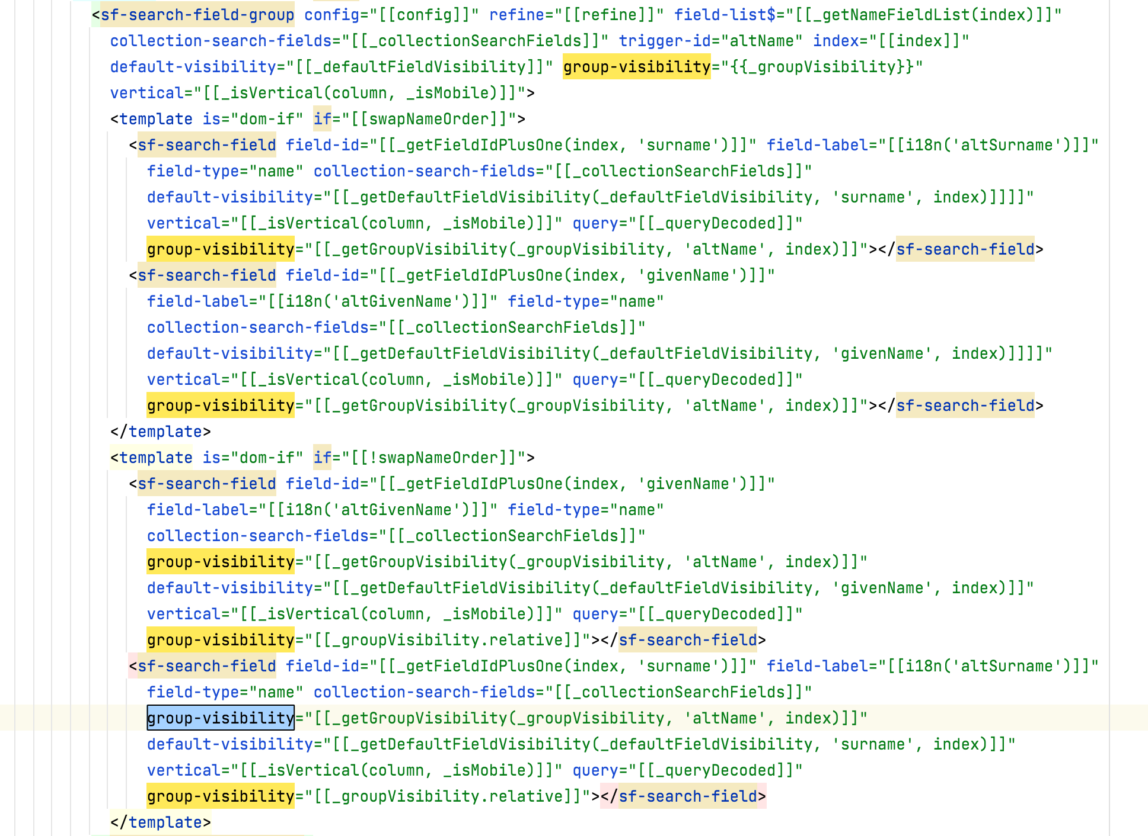
Contexts help us avoid prop drilling
Notes:
Polymer required prop drilling, and our HTML layouts were awful!
- Adding a prop required adding it everywhere
- Modifying something was a major chore

Slide 25
Contexts are not state managers
But contexts can contain state managers.
You still need to decide how to organize state variables inside your context bucket:
Props
Derived State
useState
useReducer

Slide 26
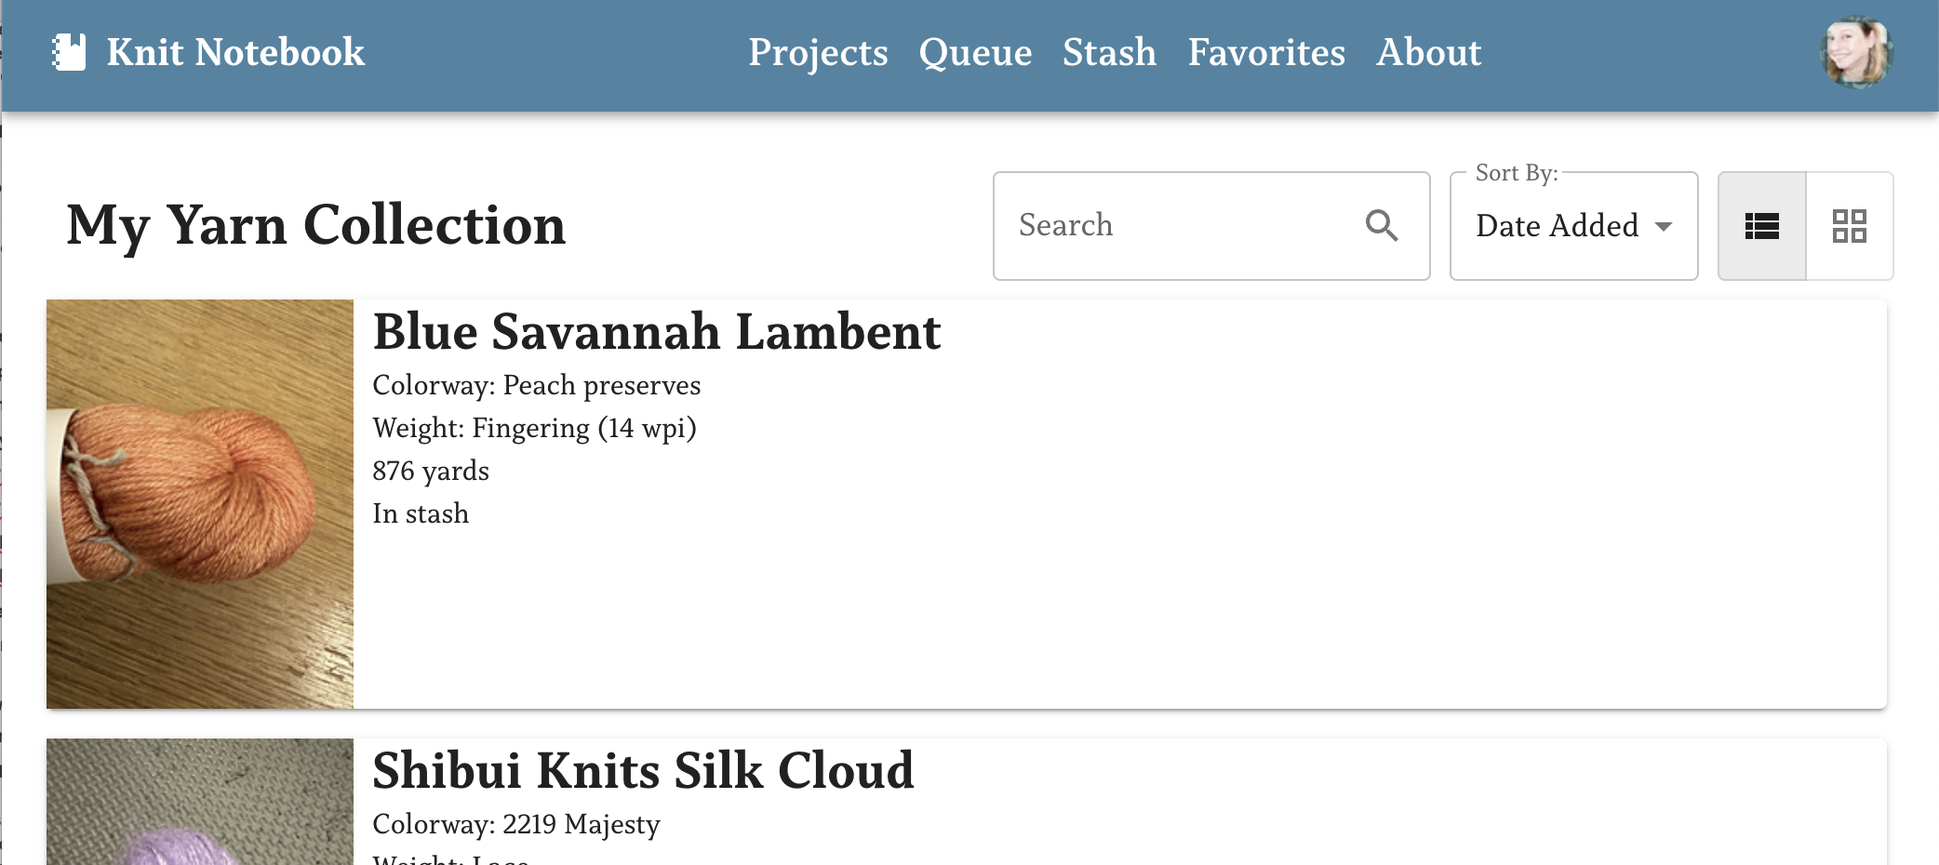
Example: Results Display Preferences
Users can set preferences for how they want their search results to appear
…. over there!
This is the perfect situation for a context!

Slide 27
Example: DisplayPrefsProvider
Create variable using createContext()
import { createContext } from "react" const DisplayPrefsContext = createContext([])
export default function DisplayPrefsProvider({ initialPrefs, children }) {
const [displayPrefs, setDisplayPrefs] = useState( initialPrefs || { resultsStyle: "list" } )
Export Provider component
return ( <DisplayPrefsContext.Provider value={{ displayPrefs, setDisplayPrefs }}> {children} </DisplayPrefsContext.Provider> )}
Return JSX
with provider
& children

Slide 28
Example: DisplayPrefsProvider
Export custom hook for accessing & updating context
export function useDisplayPrefs() { const { displayPrefs, setDisplayPrefs} =
useContext(DisplayPrefsContext) return { displayPrefs, setDisplayPrefs }
}
Hook uses context directly

Slide 29
Example: Using DisplayPrefsProvider
Context hooks are not available in this component!
export default function SearchPage({ initialPrefs }) {
return ( <DisplayPrefsProvider initialPrefs={initialPrefs}> <DisplayPrefOptions /> </DisplayPrefsProvider> )}
const {displayPrefs, setDisplayPrefs} = useDisplayPrefs()
A component brings in the provider
Context hooks are available inside children.

Slide 30
Example: Using DisplayPrefsProvider
Child component uses the hook
function DisplayPrefsOptions() { const {displayPrefs, setDisplayPrefs} = useDisplayPrefs() return ( <Button onClick={() => { setDisplayPrefs((p) => !p.moreOptions) }} > {displayPrefs.moreOptions ? 'Fewer Options' : 'More Options'} </Button> ) }
Make changes to the context by calling a function in the hook

Slide 31
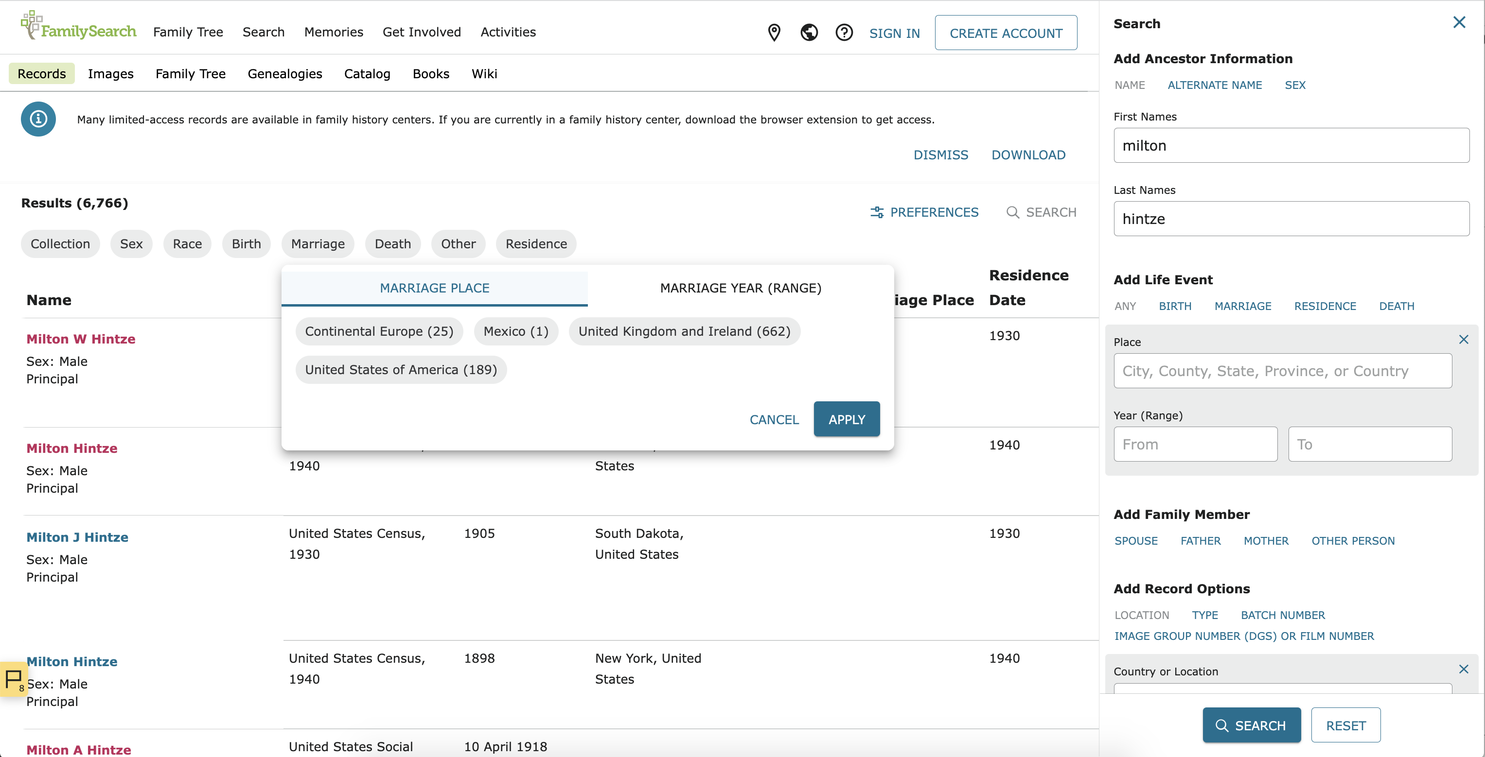
Organizing Contexts: Search Results
Search Results has top-level contexts
The search form has its own context
\
Filters have their own context!

Slide 32
Contexts Pro Tip: Calculate before Storing
Do expensive calculations in the context component
If you do an expensive calculation a custom hook, every time the hook is used, you re-calucate.

Slide 33
Additional State Bucket Options
URL Query String
Local-Type Storage
State Libraries
API/Browser Network Cache
Notes:
There are other places to store state! Each of them has advantages/disadvantages and times you want to use them. Most of the time you will use them in addition to contexts and custom hooks. I won’t go into them more deeply here, but I do use each of them in my demo project.

Slide 34

Composition
Organizing All the State Bits into a cohesive application

Slide 35
Composition Building Blocks
Display Components
Context Components
Custom Hooks
Non-React Functions

Slide 36
Composition using Contexts
Focus on state data & state management
Break down complex contexts into smaller components as needed
Put each context at the lowest possible level
Create appropriate custom hooks

Slide 37
Composition using Display Components
Move logic to custom hooks or context components
Focus on the UI

Slide 38
Composition using Custom Hooks
Some will be single-purpose
Some will be generic and reusable
Components can use multiple hooks

Slide 39
Organize Your Custom Hooks
One component could include separate hooks by function:
Handle URL management
Handle analytics
Handle display preferences
Etc.
Notes:
I looked at a single component at FamilySearch, and it had over 100 lines of logic before we got to the JSX!

Slide 40
Composition using Non-React Functions
Move complex logic into their own functions
Break logic into smaller functions as needed
functions can be unit-tested in isolation

Slide 41

React’s “Single Source of Truth” Principle
Data has one source of truth
Data only flows down
Notes:
Two similar variables should not try and keep each other in sync
State should live at the top of where it is needed
Functions to change state are passed down
If another variable is similar:
Use derived state
Set the related variable lower, based on the main variable
Set the two variables at the same time (use a reducer)

Slide 42
What does this “one way” principle mean?
Two similar variables should not try and keep each other in sync
State should live at the top of where it is needed
Functions to change state are passed down
If another variable is similar:
Use derived state
Set the related variable lower, based on the main variable
Set the two variables at the same time (use a reducer)
Notes:
Tell story about the outage where someone broke this principle

Slide 43
Combining the building blocks
Notes:
We’ve talked about state management, state buckets, and composition. How do we

Slide 44
How to Start a Complex Project
Find the foundation of the big project – what to do first?
Fetch some data, create a provider and a component.
Write unit tests.
Add more features, piece by piece.
Refactor frequently to keep the code maintainable.
As soon as possible, split up the work among everyone on your team!
Notes:
Get Peer reviews as often as possible

Slide 45
Organize your data as you add features
Separate complex data structures into multiple contexts
Break up “sections” of code into custom hooks
Break up components when they get complicated
Notes:
If things are not connected and can “flow down,” then you separate them.

Slide 46
Diagram Your Code!
Diagram:
data structures
algorithms
components
Diagrams:
Highlight problems
bring new people up to speed
help me remember what I did last week/year!
Notes:
Genealogical records with indexes are easier to navigate…So diagrams make code easier to navigate--
Diagrams are very useful! You can diagram data, algorithms, and components.
When we work on code, we build a mental model of our components.
That works great while we are actively working on it, but later… it helps to have diagrams to help rebuild our mental models.
When we bring a new person onto the team, diagrams become training tools.
Following are diagrams Search Web made and what they show about how we organized our code.

Slide 47
Organizing Components

Slide 48
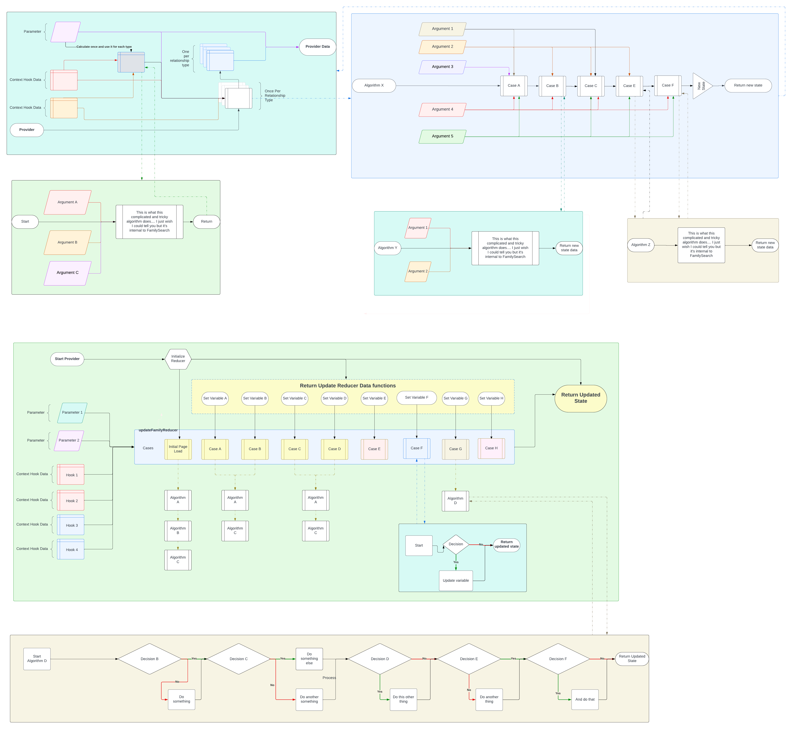
Organizing Algorithms

Slide 49
LIVE DEMO!! Refactoring complexity

Slide 50
Sample custom hook organization:
I looked at a custom hook with many lines and found:
4 lines of Random stuff
2 lines to read the query string
3 lines of drag & drop
28 lines of an algorithm
16 lines of another algorithm
18 lines of highlighting
Notes:
If I had made 5 contexts – or even 3 – the custom hook would have been much easier to read

Slide 51
Sample of Simplifying JSX – Make new components!
return ( <DataPreview.Provider loading={status === 'loading'} error={status === 'error'}> <DataPreview.Loading>{/* 9-line loading skeleton*/}</DataPreview.Loading> <DataPreview.Ready>{/* 93-line data section */}</DataPreview.Ready> <DataPreview.Error> <UnknownError /> </DataPreview.Error> </DataPreview.Provider> )
Make new components with obvious “sections”

Slide 52
Start with state closest to where you need it, then refactor

Slide 53
Putting it all together with an example
Knit Notebook
Ravelry API
Refactoring

Slide 54

Wrapping Up
I hope this presentation has given you ideas and tools for managing complex state in React.
For slides:
See QR code
Email mary.shaw@familysearch.org
Ask in UtahJS Slack: marybeshaw
Notes:
TODO: QR CODE

